Slide 1
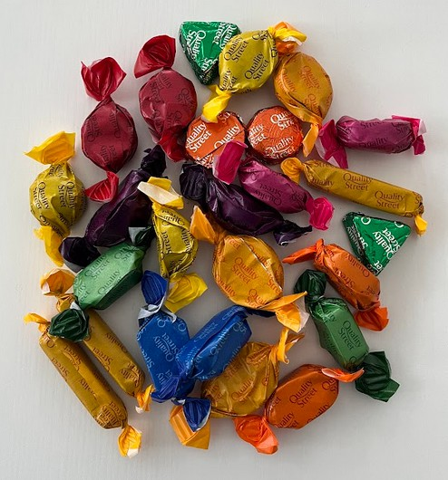
Machine Learning Workshop
In this activity you will train the computer to recognise images from a webcam.
We will use a web browser application called Teachable Machine which is a fun, easy way to create machine learning models - no coding required and by the end of this activity you will have trained the computer to recognise different sweets.
WARNING
Allergy statement: During this activity you may come into contact with WHEAT, EGGS, TREE NUTS, and MILK. For more information, please speak with a member of staff.

Slide 2

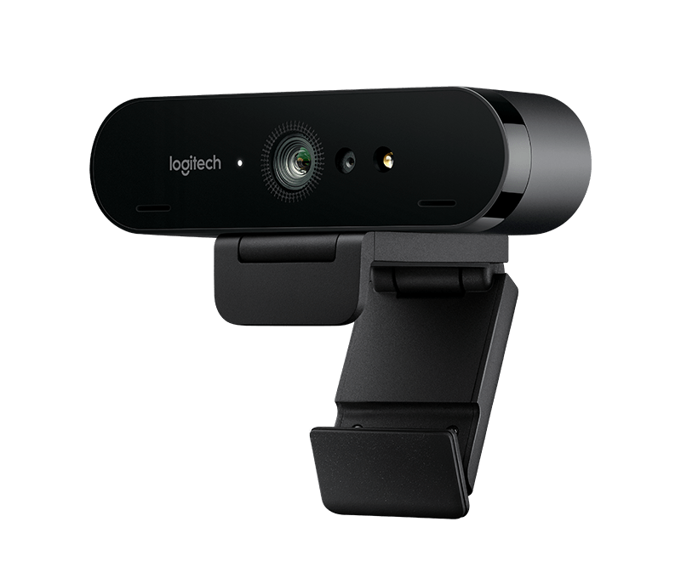
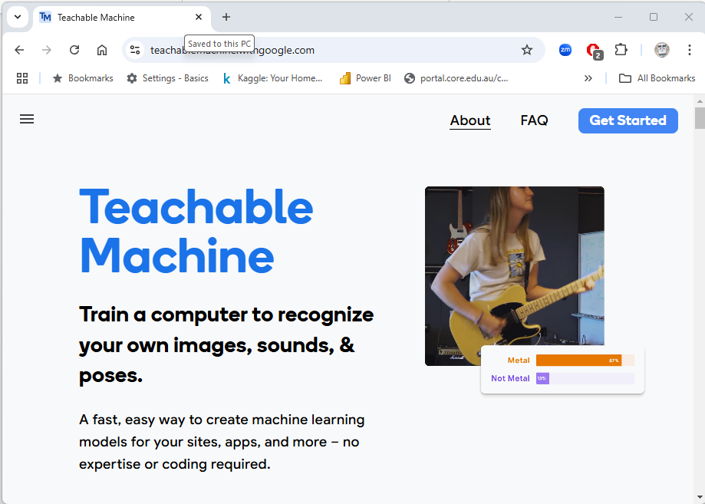
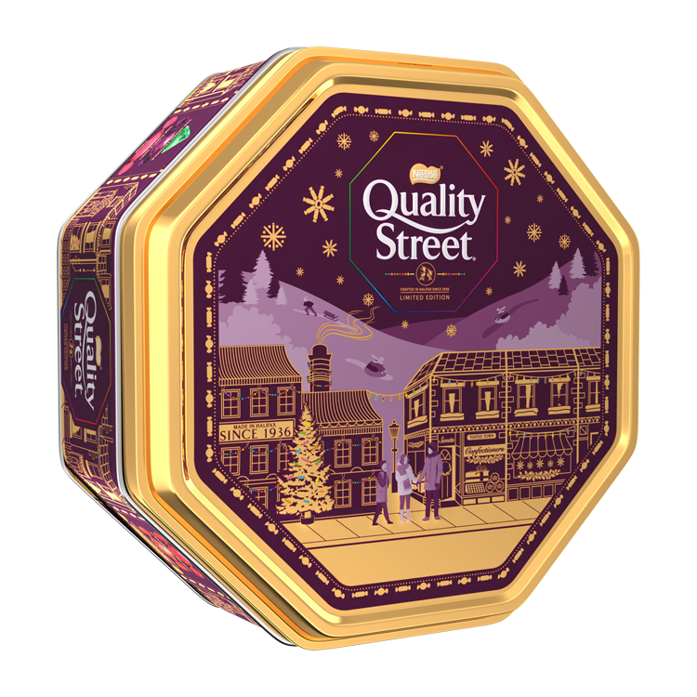
Let’s get going!
What do we need!
For this activity we need the following:
A web browser (we recommend you use Chrome).
A webcam connected to the computer.
Some sweets.
The lab computers should already be setup, but if you get stuck at any point, ask for help. We are here to help you and don't worry if you don't get everything finished in this session.
Source files: https://github.com/neliot/sweeties

Slide 3
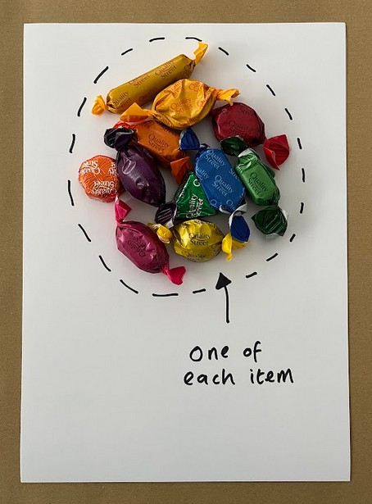
Let’s get going!
Gather your items
Gather up the sweets that you're using - you'll need one of each type of sweet. This is what we are going to use AI to carry out some classification!
In this guide we use Quality Street chocolates, but yours might be different.
Resist the temptation! You can have some later!

Slide 4
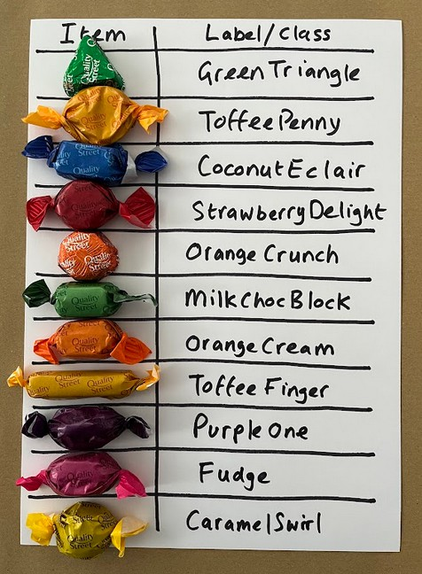
Let’s get going!
Gather your items
Identify each sweet and allocate an appropriate class/label. You might need to look at the key on the side of the box.
No Really! - resist the temptation! You can have some later!

Slide 5
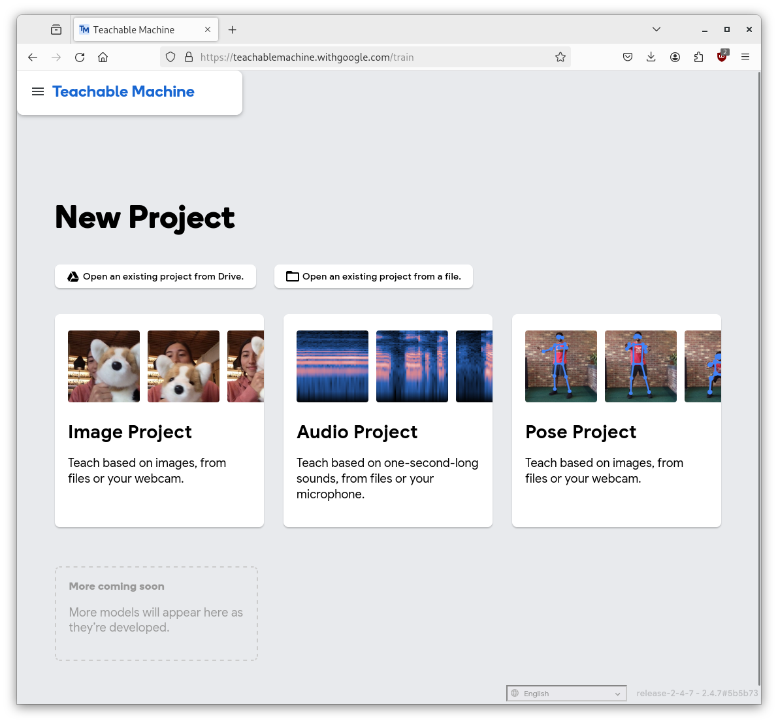
Build the model!
Let’s get classifying
Time to show the computer the sweets and train a model. We're going to use a website called Teachable Machine which has been developed by Google. It makes it easy to create models.
Open Teachable Machine in another window by right clicking on the following link below and selecting open a new window.
https://teachablemachine.withgoogle.com/
You should see a screen that looks like this:
This option lets us work with the webcam!

Slide 6
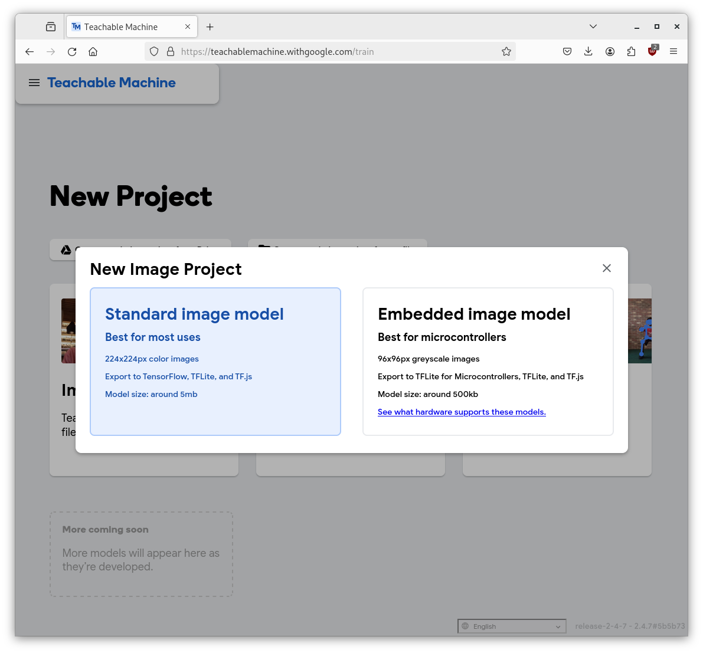
Build the model!
Let’s get classifying
Hopefully you are now seeing a screen like this!
This is the that lets us build a Standard Image Model!

Slide 7
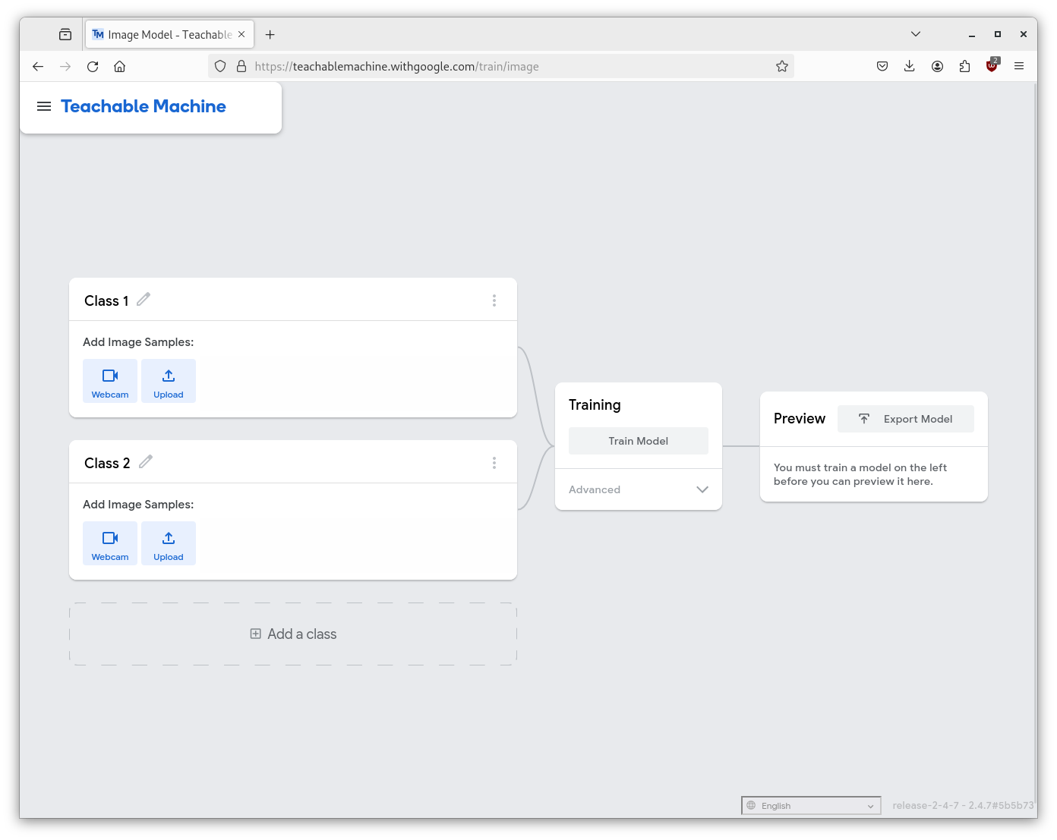
Build the model!
Let’s get classifying
Your screen should look something like below:
NOTE: Class names cannot have spaces!
Rename Class 1 by clicking the edit icon and name it to your first sweet. In our example its the Quality Street Green Triangle.

Slide 8
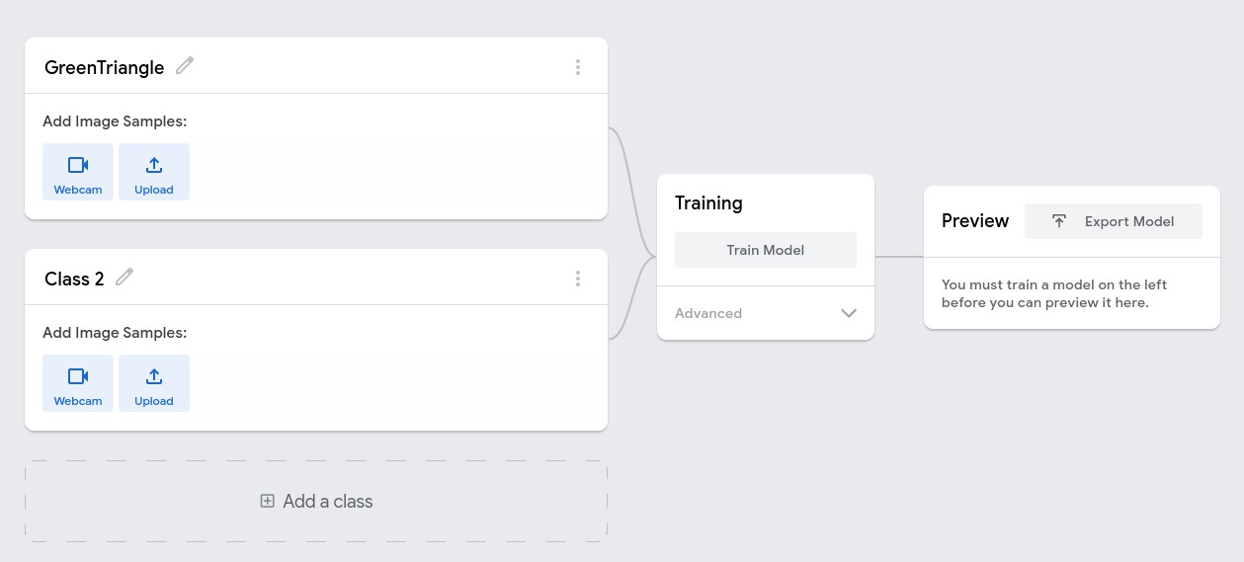
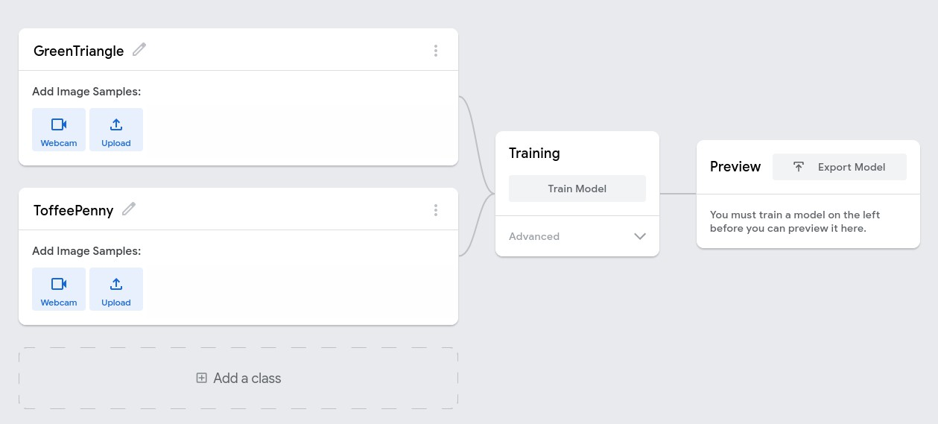
Build the model!
Let’s get classifying
Do the same for Class 2 and rename it to your next sweet. In our example it’s the classic toffee penny (ToffeePenny)

Slide 9
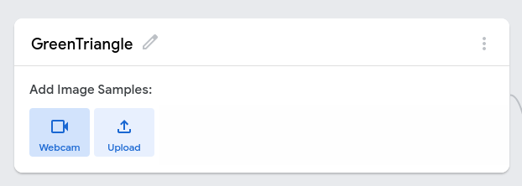
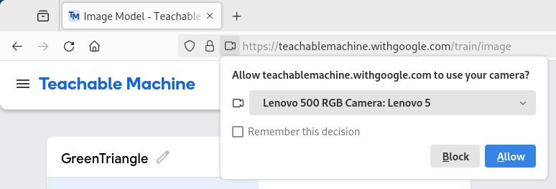
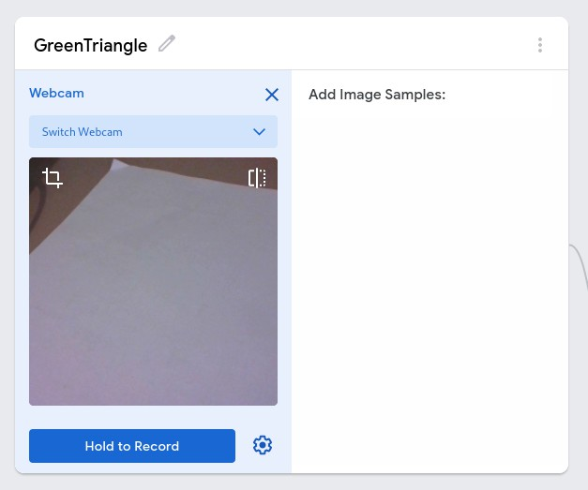
Build the model!
Time to add the photos (webcam)
Click the Webcam for the first Class (GreenTriangle)
Your browser may ask for permission to use the Webcam. Check the Remember this decision checkbox and click Allow.
If all goes well, the webcam will start and you'll see a preview

Slide 10
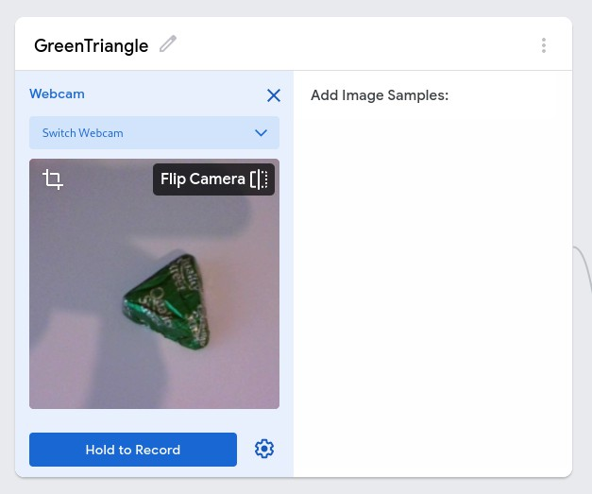
Build the model!
Time to add the photos (webcam)
Before you begin the next part works best if you have a plain background. Also, you can hold the webcam to get a better photo of the sweets.
To record images, press the Hold to Record button

Slide 11
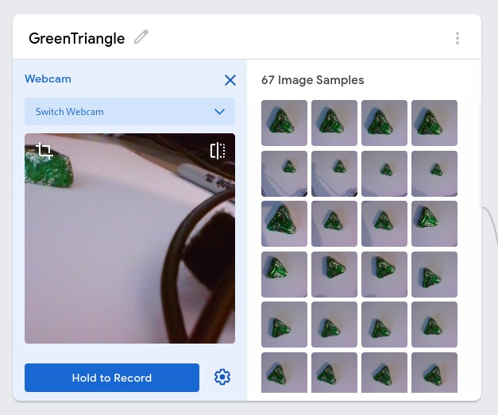
Build the model!
Time to add the photos (webcam)
The webcam will start taking photos at regular intervals. Make sure you move the webcam around a little to get the sweet in different positions. This will improve the effectiveness of the model.
NOTE: If you make a mistake, you can always remove an image.

Slide 12
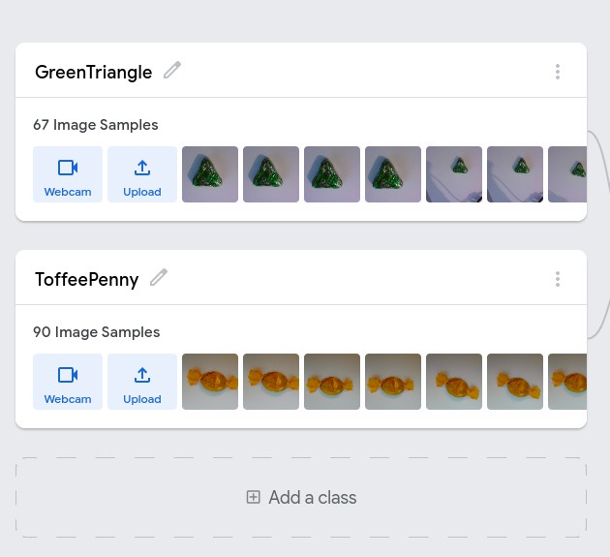
Build the model!
Time to add another class
Once you have the images from the webcam for the sweet you can move on.
When you started the process teachable machine added two class, there’s no point in just having one! So, add your next sweet.

Slide 13

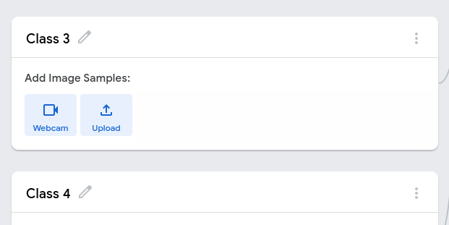
Build the model!
Add the rest of the classes
There are 11 sweet varieties in the Quality Street box. To add the rest, select the “Add a class” and repeat the process.
When you have finished there is one more class to add.
What about when there’s no sweet. Add an additional class called “None” and using the webcam make a class based on the “background” of where you took the sweet photos.

Slide 14
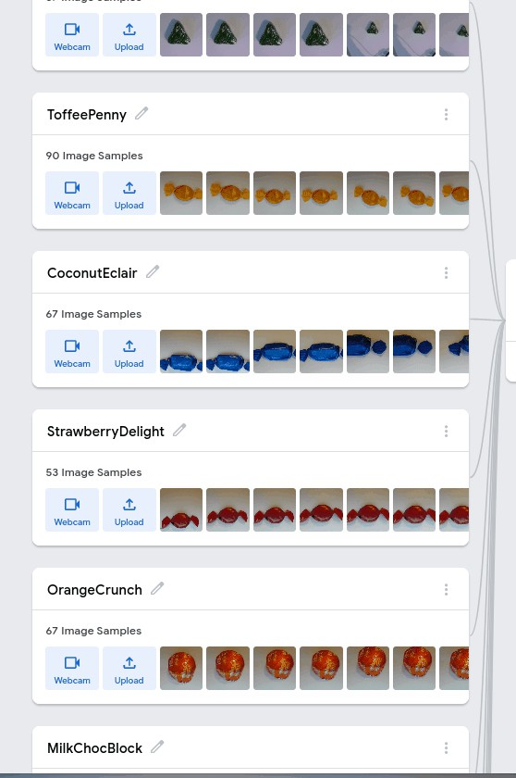
Build the model!
All classes added
If all went well, you'll have something that looks something like the picture below.
That’s your dataset created for the sweety sorter. Now we need to convert the dataset into an AI model.

Slide 15
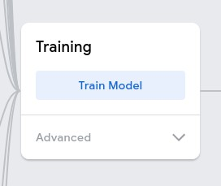
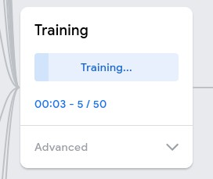
Build the model!
Let’s build the model!
To train the model each photo from each class is converted into a set of numbers that are then passed through a neural network to produce a model.
To start the training process, select the “Train Model” option. Be patient it does take a while; there’s a lot of photos!
You can see the progress of the model training. Once you select the “Train Model” button it becomes a progress bar.

Slide 16
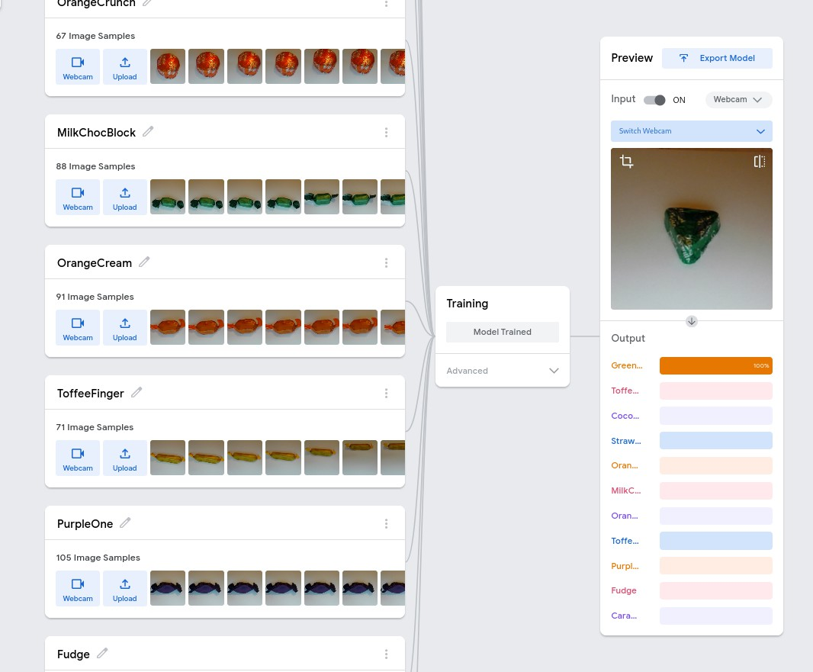
Build the model!
Check the model!
Once the training is complete “Teachable Machine” provides you with a very basic testing facility. You can point the webcam at the sweets, and it will try and identify them.
The bars show you how confident the model is when predicting the match.

Slide 17
Build the model!
Before you move on
Did it work as expected?
What happens when you present a sweet at an angle, or only show part of the sweet to the webcam?
What happens when you don't present a sweet to the webcam? Has your “None” class worked?
What's happens if you present a different sweet that wasn’t in your training set (put something in front of the webcam)?
How do you think you could improve the training data?
Have a chat with other students to see what they think.

Slide 18
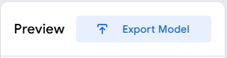
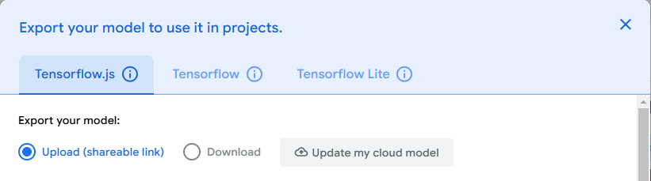
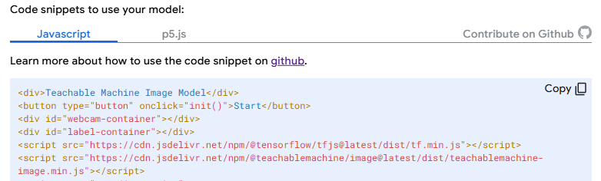
Use the model!
Let’s upload the project so we can use it.
Click Export Model
Click Upload (shareable link) radio button
You'll also see two important things now. The Sharable link.
And the sample code which will already have the shared link in the code for you.
Copy the code!

Slide 19
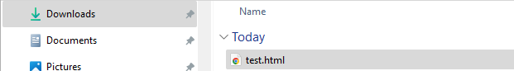
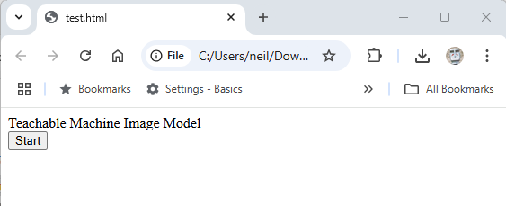
Use the model!
Let’s use the sample code.
Open a text editor (Notepad or VS Code) and paste the code into the file.
Save the code into a file as test.html. You can save it to the in your Downloads folder for ease.
Browse to the Downloads folder and double click the file.
Click the Start button and wave some sweets in front of the webcam!

Slide 20
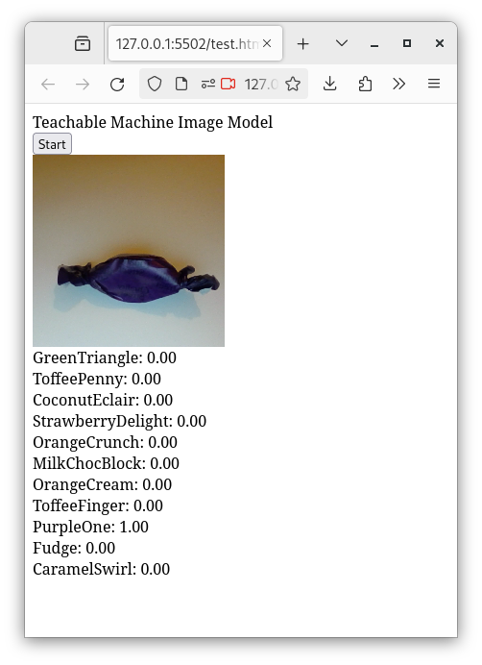
Use the model!
Let’s use the sample code.
You are now running your own AI model in a browser!
It’s all down to your imagination now. What could you use this technology for?
What about record faces with the class name as an ID to create a login facility? Is that better than a password?

Slide 21
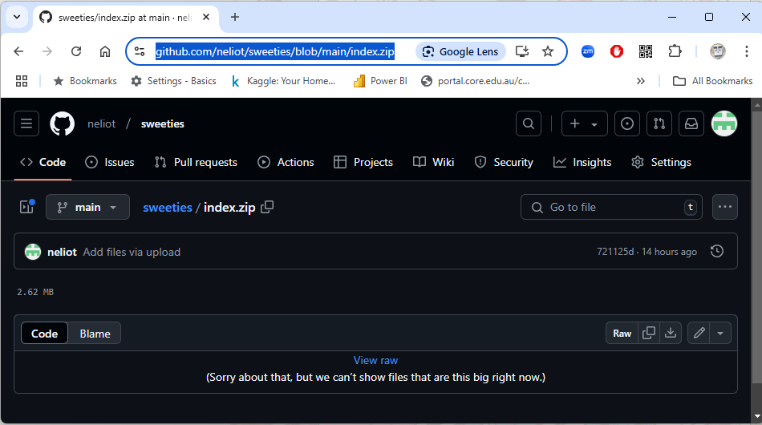
Use the model!
What about building applications?
Now that you have the model in use using the sample code lets look at how a simple app can be built around the model.
Download the sample app (zip file) from the GitHub repository and unzip it into a folder.
https://github.com/neliot/sweeties/blob/main/index.zip
Select the download option from here

Slide 22
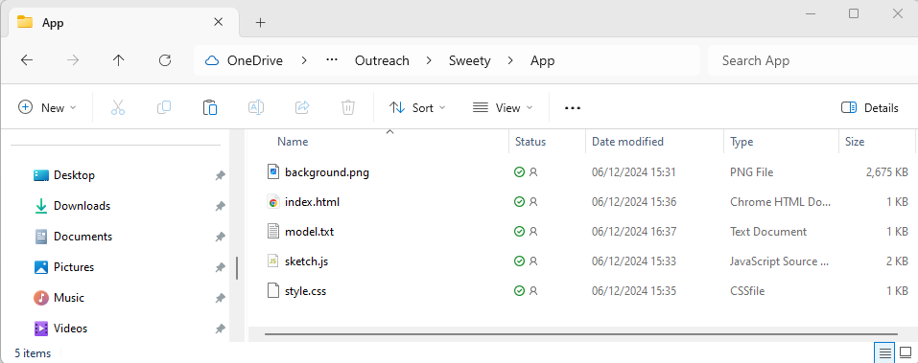
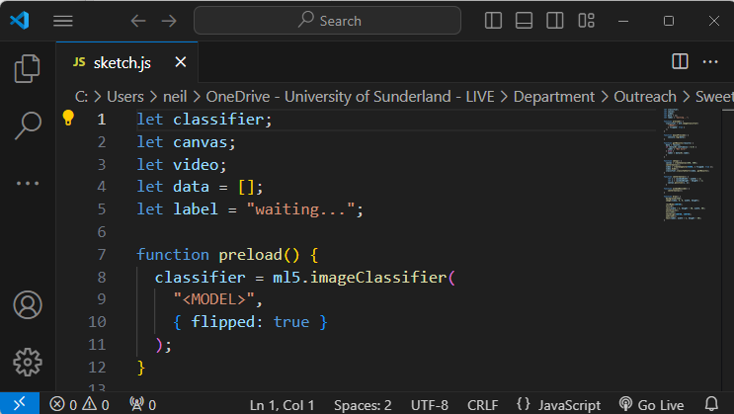
Use the model!
What about building applications?
Open a file explorer and navigate to the folder where you expanded the zip file.
Right Click on the sketch.js file and use the open with option to open the file in an editor such as Visual Studio Code.
Replace the <MODEL> placeholder with the URL for the model you create in Teachable Machine.

Slide 23
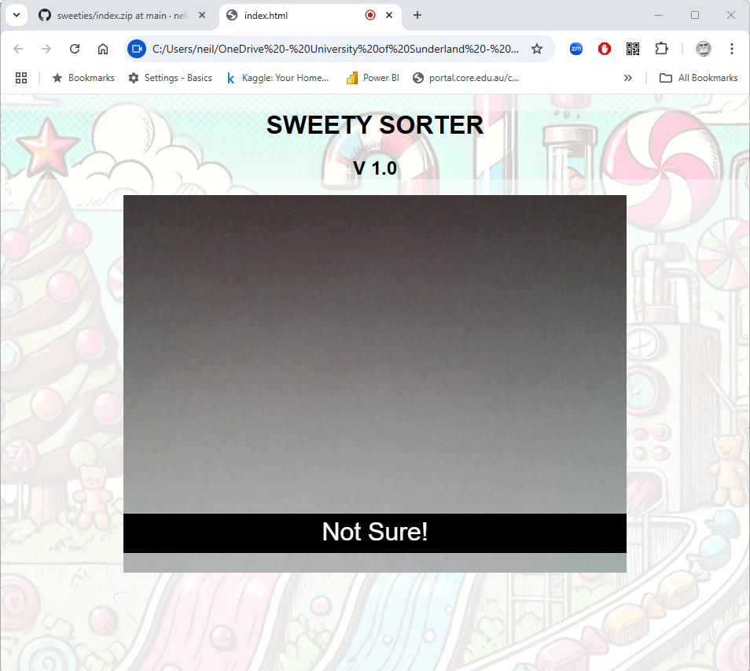
Use the model!
What about building applications?
If you didn’t manage to create your own model for this. Go back to the folder and there is a text file called “model.txt”. It contains a URL to a pre-trained sweety model for you.
Each sweet has been scanned on a white background for the model.
Now you can launch the application. Right Click the index.html file and use the open with option to open the file in a web browser such as Firefox.
Now you can launch the application. Right Click the index.html file and use the open with option to open the file in a web browser such as Firefox.

Slide 24
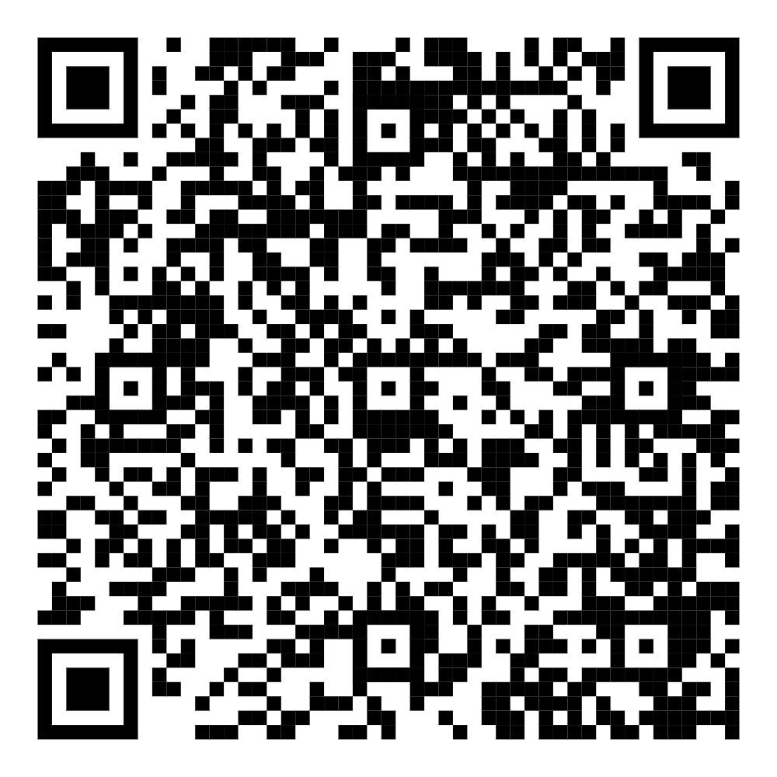
And Finally!
On the BSc Computer Science Programme at the University of Sunderland you'll study AI and Machine Learning in more detail, which means you'll be able to create some amazing things and have a good grasp on this important emerging technology.

Slide 25
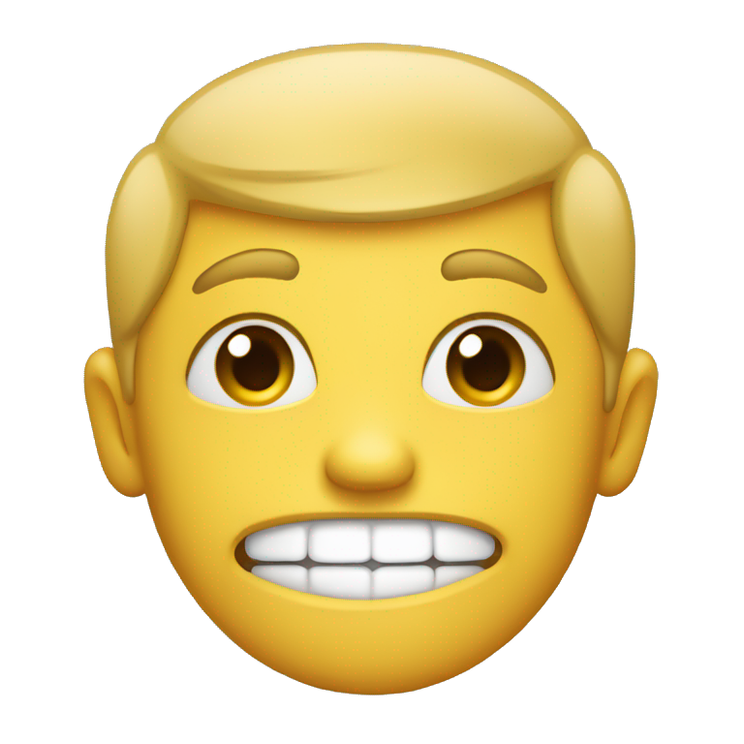
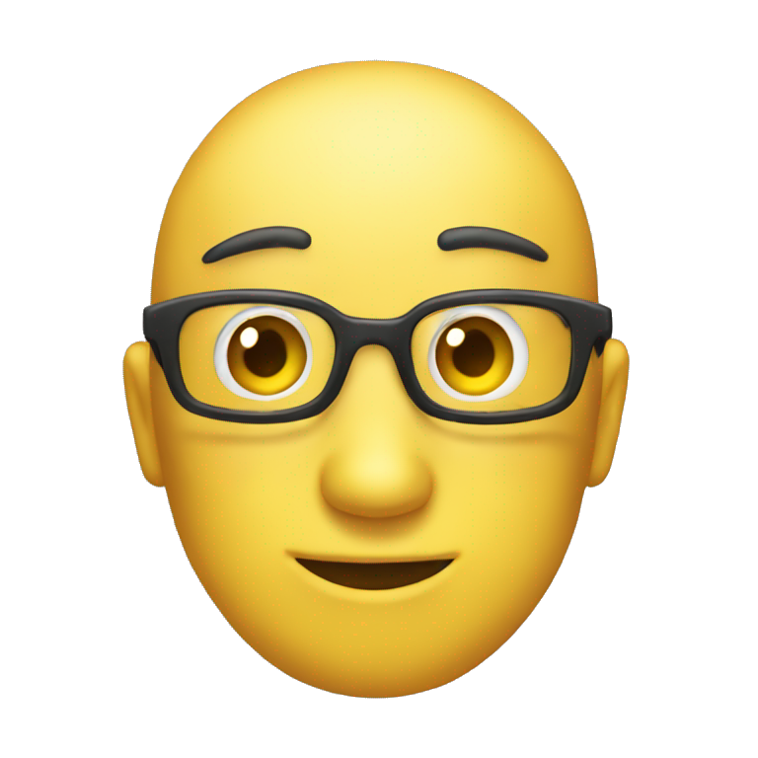
Fancy a
Challenge?
Build a new model of the faces of all the people in your “team” (and other attendees if they are willing) and using the sample application check that the system can identify each of you.
Don’t forget to update the model URL in the sketch.js file.
Don’t forget to add the “None” class. The model will always try and match to at least one Class, so you need a fall back!
Remember no spaces in the Class names!

